Slide 1
ICT 2103 Digital Logic Design
Prof. Dr. Muhammad Shahin Uddin
Email: shahin.uddin@mbstu.ac.bd

Slide 2
Boolean Algebra

Slide 3
Algebras
What is an algebra?
Mathematical system consisting of
Set of elements
Set of operators
Axioms or postulates
Why is it important?
Defines rules of “calculations”
Example: arithmetic on natural numbers
Set of elements: N = {1,2,3,4,…}
Operator: +, –, * /
Axioms: associativity, distributivity, closure, identity elements, etc.
Note: operators with two inputs are called binary
Does not mean they are restricted to binary numbers!
Operator(s) with one input are called unary

Slide 4
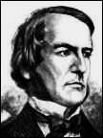
George Boole
Father of Boolean Algebra
He came up with a type of linguistic algebra, the three most basic operations of which were (and still are) AND, OR and NOT. It was these three functions that formed the basis of his premise, and were the only operations necessary to perform comparisons or basic mathematical functions.
Boole’s system (detailed in his 'An Investigation of the Laws of Thought, on Which Are Founded the Mathematical Theories of Logic and Probabilities', 1854) was based on a binary approach, processing only two objects - the yes-no, true-false, on-off, zero-one approach.
Surprisingly, given his standing in the academic community, Boole's idea was either criticized or completely ignored by the majority of his peers.
Eventually, one bright student, Claude Shannon (1916-2001), picked up the idea and ran with it
George Boole (1815 - 1864)

Slide 5
Binary Logic and Gates
Binary variables take on one of two values.
Logical operators operate on binary values and binary variables.
Basic logical operators are the logic functions AND, OR and NOT.
Logic gates implement logic functions.
Boolean Algebra: a useful mathematical system for specifying and transforming logic functions.
We study Boolean algebra as foundation for designing and analyzing digital systems!

Slide 6
Binary Variables
Recall that the two binary values have different names:
True/False
On/Off
Yes/No
1/0
We use 1 and 0 to denote the two values.
Variable identifier examples:
A, B, y, z, or X₁ for now
RESET, START_IT, or ADD1 later

Slide 7
Logical Operations
The three basic logical operations are:
AND
OR
NOT
AND is denoted by a dot (·).
OR is denoted by a plus (+).
NOT is denoted by an overbar ( ¯ ), a single quote mark (') after, or (~) before the variable.

Slide 8
Boolean Functions
A Boolean function
Binary variables
Binary operators OR and AND
Unary operator NOT
Parentheses
Examples
F₁= x. y. z'
F₂ = x + y’.z
F₃ = x' .y’ .z + x' .y .z + x .y'
F₄ = (x. y' + x' .z)

Slide 9
Properties of Boolean Algebra
Property | AND | OR
Commutative | AB=BA | A+B=B+A
Associative | (AB)C=A(BC) | (A+B)+C=A+(B+C)
Distributive | A(B+C)=AB+AC | A+(BC)=(A+B)(A+C)
Identity | A1=A | A+0=A
Complement | A(A’)=0 | A+A’=1
DeMorgan’s Law | (AB)’=A’ + B’ | (A+B)’=A’B’

Slide 10
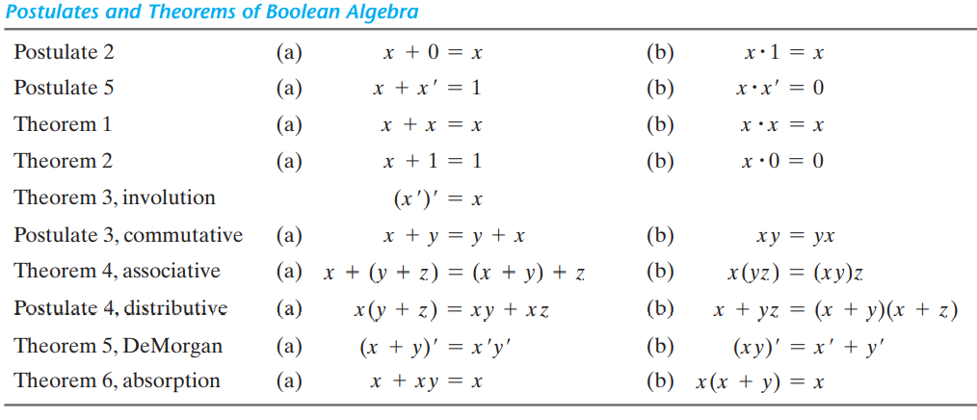
Boolean Algebra: Basic Theorems
The theorems and postulates listed are the most basic relationships in Boolean algebra.
Postulates and Theorems of Boolean Algebra are:

Slide 11
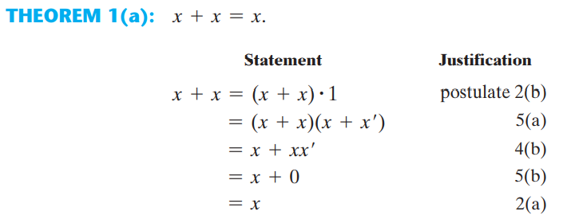
Proof

Slide 12
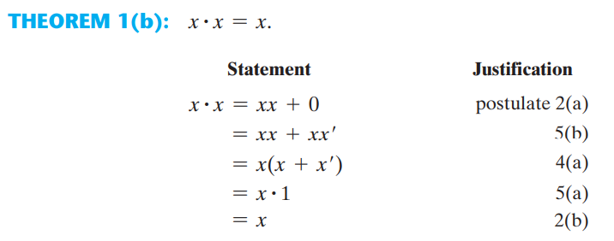
Proof

Slide 13
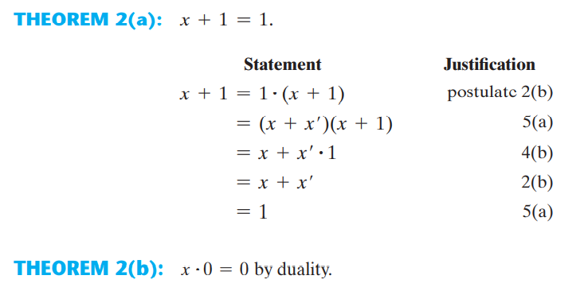
Proof

Slide 14
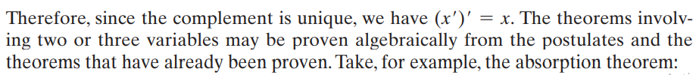
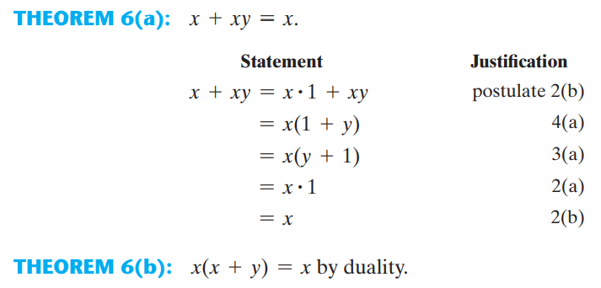
Proof

Slide 15
Example:
Simplify the following Boolean functions to a minimum number of literals.
1. x(x + y) = xx + xy = 0 + xy = xy.
2. x + xy = (x + x)(x + y) = 1(x + y) = x + y.
3. (x + y)(x + y) = x + xy + xy + yy = x(1 + y + y) = x.
4. xy + xz + yz = xy + xz + yz(x + x) = xy + xz + xyz + xyz = xy(1 + z) + xz(1 + y) = xy + xz.
5. (x + y)(x + z)(y + z) = (x + y)(x + z), by duality from function 4.

Slide 16
Example:
Simplify the following Boolean functions to a minimum number of literals.
1. x(x + y) = xx + xy = 0 + xy = xy.
2. x + xy = (x + x)(x + y) = 1(x + y) = x + y.
3. (x + y)(x + y) = x + xy + xy + yy = x(1 + y + y) = x.
4. xy + xz + yz = xy + xz + yz(x + x) = xy + xz + xyz + xyz = xy(1 + z) + xz(1 + y) = xy + xz.
5. (x + y)(x + z)(y + z) = (x + y)(x + z), by duality from function 4.

Slide 17
Complement of a Function
The complement of a function F is F’ and is obtained from an interchange of 0’s for 1’s and 1’s for 0’s in the value of F.
DeMorgan’s theorems can be extended to three or more variables. The three‐variable form of the first DeMorgan’s theorem is derived as follows:
(A+B+C)’=(A+x)’=A’x’=A’(B+C)’= A’B’C’
DeMorgan’s theorems can be generalized as follows:
(A + B + C + D + G + F)’ = A’B’C’D’…..F’
(ABCDF)’ = A’+ B’+ C’+D’+G’+F’
The generalized form of DeMorgan’s theorems states that the complement of a function is obtained by interchanging AND and OR operators and complementing each literal.

Slide 18
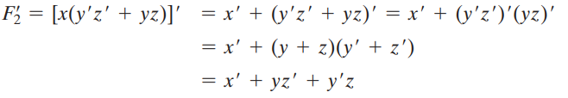

Slide 19
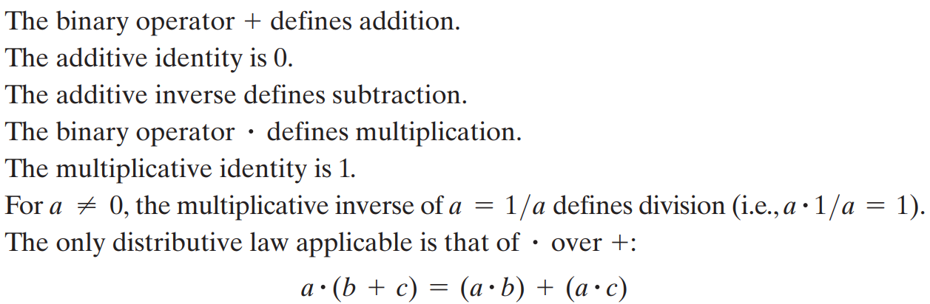
The operators and postulates have the following meanings:

Slide 20
Notation Examples
Examples:
A.B is read “Y is equal to A AND B.”
Z=X+Y is read “Z is equal to X OR Y.”
X=A’ is read “X is equal to NOT A.”
Y
=
Note: The statement:
1 + 1 = 2 (read “one plus one equals two”)
is not the same as
1 + 1 = 1 (read “1 or 1 equals 1”).

Slide 21
Logic Gates
Gate
A device that performs a basic operation on electrical signals
Boolean Expressions
Uses Boolean algebra, a mathematical notation for expressing two-valued logic
Logic Diagrams
A graphical representation of a circuit; each gate has its own symbol
Truth Tables
A table showing all possible input value and the associated output values
Timing Diagram

Slide 22
Logic Gates
Logic gates:
NOT
AND
OR
EX-OR
EX-NOR
NAND
NOR
Typically, logic diagrams are black and white with gates distinguished only by their shape

Slide 23
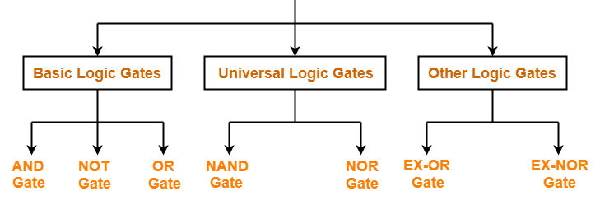
Types of Logic Gates
Logic Gates

Slide 24
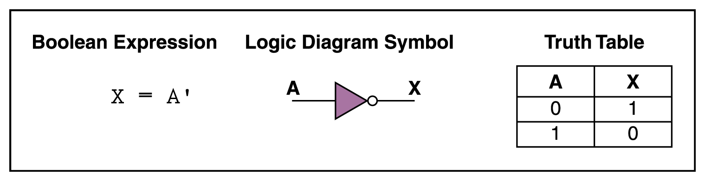
NOT Gate
A NOT gate accepts one input signal (0 or 1) and returns the opposite signal as output
The output of NOT gate is high (‘1’) if its input is low (‘0’).
The output of NOT gate is low (‘0’) if its input is high (‘1’).
It is clear that NOT gate simply inverts the given input.
Since NOT gate simply inverts the given input, therefore it is also known as Inverter Gate.

Slide 25
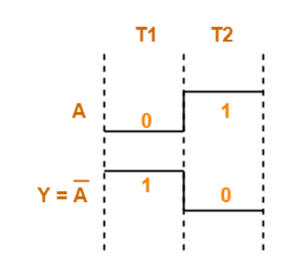
Truth Table
Truth Table for NOT Gate is as shown below-
Timing Diagram-
The timing diagram for NOT Gate is as shown below-

Slide 26
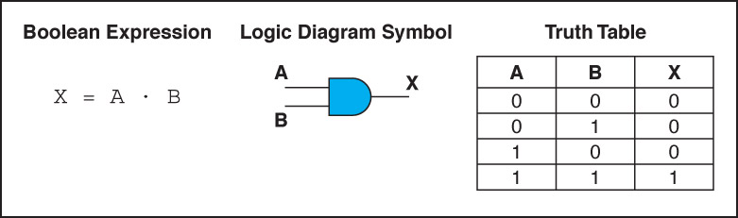
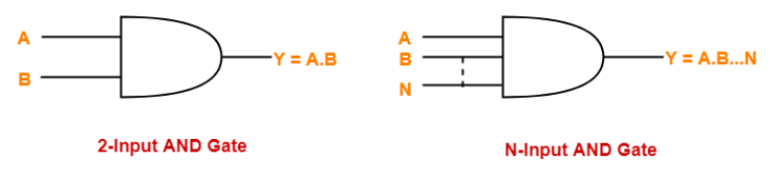
AND Gate
An AND gate accepts two/ more than two input signals
The output of AND gate is high (‘1’) if all of its inputs are high (‘1’).
The output of AND gate is low (‘0’) if any one of its inputs is low (‘0’).

Slide 27
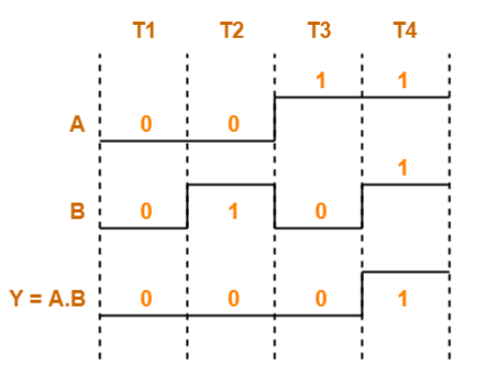
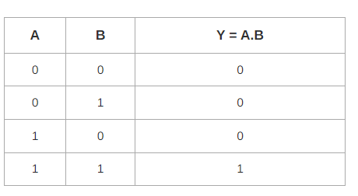
Truth Table-
The truth table for AND Gate is as shown below-
Timing Diagram-
The timing diagram for AND Gate is as shown below-

Slide 28
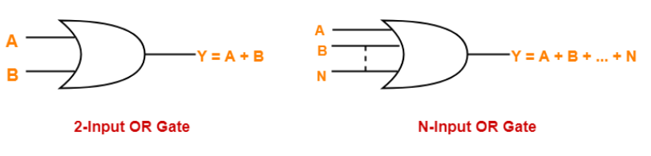
OR Gate
The output of OR gate is high (‘1’) if any one of its inputs is high (‘1’).
The output of OR gate is low (‘0’) if all of its inputs are low (‘0’).
Logic Symbol-
The logic symbol for OR Gate is as shown below-

Slide 29
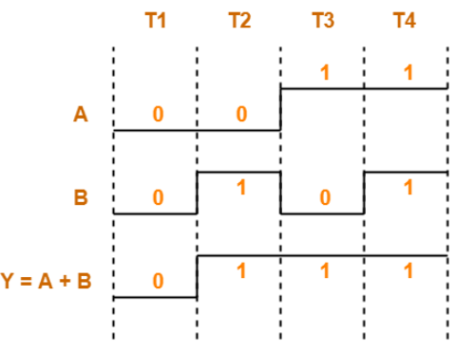
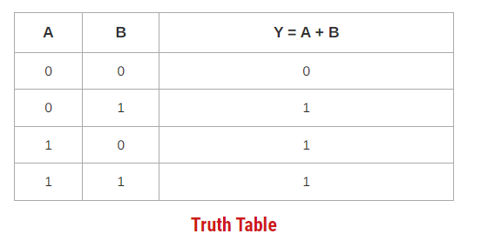
Truth Table-
The truth table for OR Gate is as shown below-
Timing Diagram-
The timing diagram for OR Gate is as shown below-

Slide 30
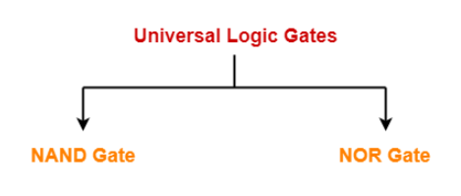
Universal Logic Gates-
Universal logic gates are the logic gates that are capable of implementing any Boolean function without requiring any other type of gate.
They are called as “Universal Gates” because- They can realize all the binary operations.
All the basic logic gates can be derived from them.
They have the following properties-
Universal gates are not associative in nature.
Universal gates are commutative in nature.
There are following two universal logic gates-

Slide 31
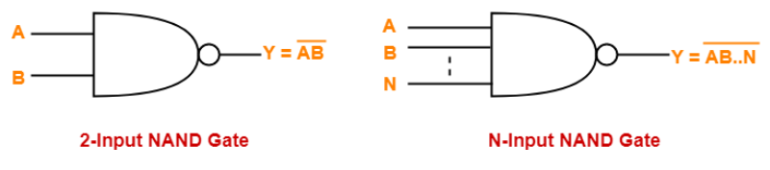
Universal Logic Gates: NAND Gate-
A NAND Gate is constructed by connecting a NOT Gate at the output terminal of the AND Gate.
The output of NAND gate is high (‘1’) if at least one of its inputs is low (‘0’).
The output of NAND gate is low (‘0’) if all of its inputs are high (‘1’).
Logic Symbol-
The logic symbol for NAND Gate is as shown below-

Slide 32
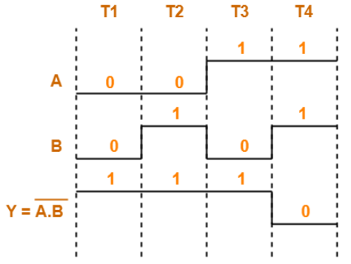
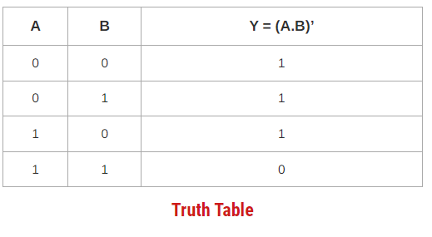
Truth Table-
The truth table for NAND Gate is as shown below-
Timing Diagram-
The timing diagram for NAND Gate is as shown below-

Slide 33
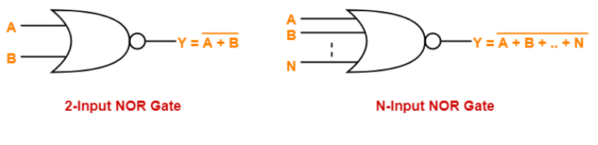
Universal Logic Gates: NOR Gate
A NOR Gate is constructed by connecting a NOT Gate at the output terminal of the OR Gate.
The output of OR gate is high (‘1’) if all of its inputs are low (‘0’).
The output of OR gate is low (‘0’) if any of its inputs is high (‘1’).
Logic Symbol-
The logic symbol for NOR Gate is as shown below-

Slide 34
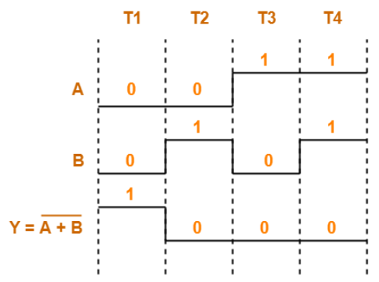
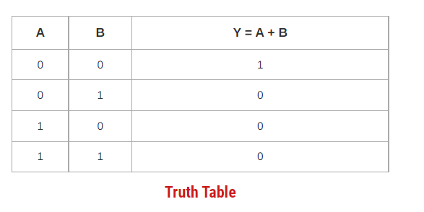
Truth Table-
The truth table for NOR Gate is as shown below-
Timing Diagram-
The timing diagram for NOR Gate is as shown below-

Slide 35
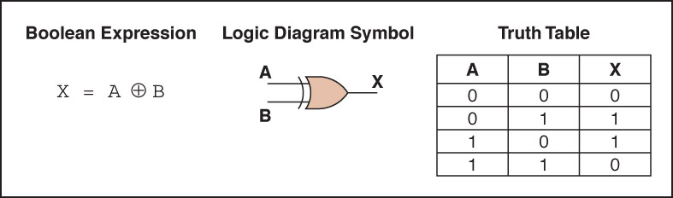
XOR Gate
An XOR gate accepts two input signals
If both are the same, the output is 0; otherwise, the output is 1

Slide 36
EX-OR Gate
Note the difference between the XOR gate and the OR gate; they differ only in one input situation
When both input signals are 1, the OR gate produces a 1 and the XOR produces a 0
XOR is called the exclusive OR

Slide 37
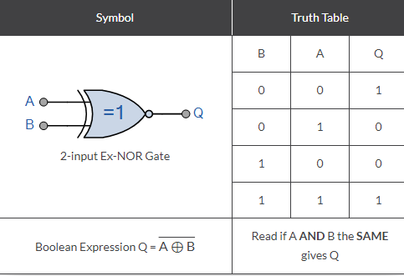
EX-NOR Gate
EXNOR gate means exclusive NOR gate and is a combination of X-OR and NOT gate. It also has two inputs and one output. When both the inputs are at 0, the output of the EXNOR gate will be high i.e.1. If one of the input is 0 and the other is 1 the output will be 0, and the gate is known as Coincidence gate.

Slide 38
Draw a circuit diagram for f= (xy' + x'y)z.

Slide 39
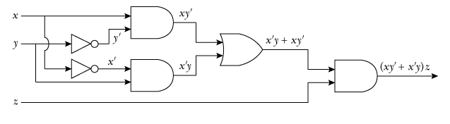
Draw a circuit diagram for f= (xy' + x'y)z.

Slide 40
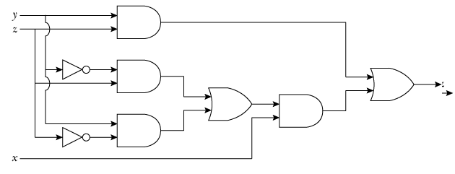
Find the Boolean expression for the following circuit

Slide 41
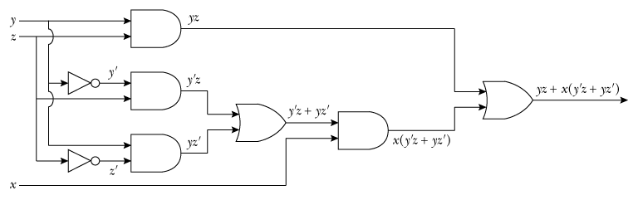
The Boolean expression that represent the circuit in the following Figure is yz+x(yz’+y’z)

Slide 42
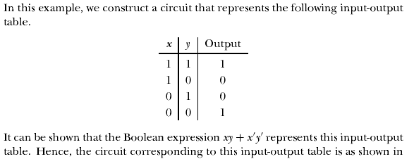
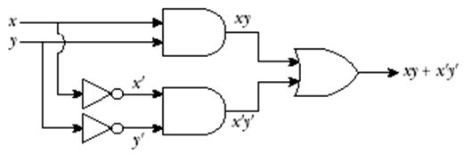
Example:

Slide 43
A circuit for two light switches
EXAMPLE
F(x,y)=1 when the light is on
F(x,y)=0 when the light is off
When both switches are closed, the light is on: F(1,1)=1, this implies
When we open one switch, the light is off: F(1,0)=F(0,1)=0
When the other switch is also open, the light is on: F(0,0)=1

Slide 44
Thus, we get:
x | y | F(x,y)
1 | 1 | 1
1 | 0 | 0
0 | 1 | 0
0 | 0 | 1
Which Boolean expression is given by F?
F(x,y) = xy + x'y'
Draw a circuit for F,
i.e., a circuit to control two light switches.

Slide 45
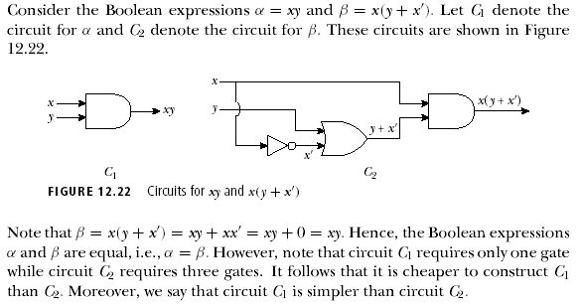
EXAMPLE:

Slide 46

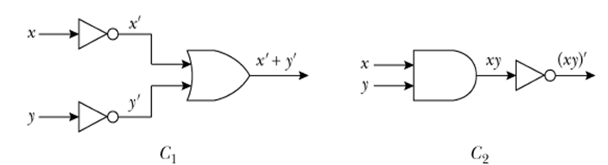
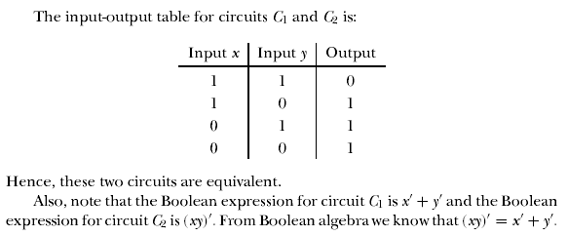
EXAMPLE:

Slide 47

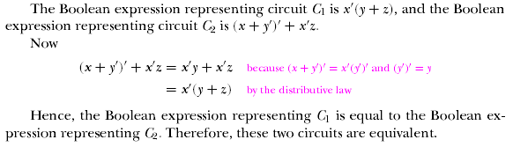
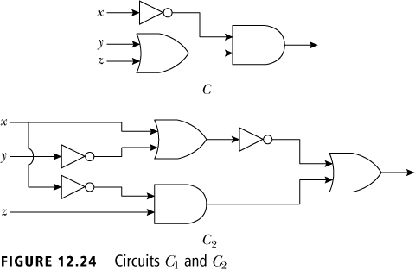

Slide 48
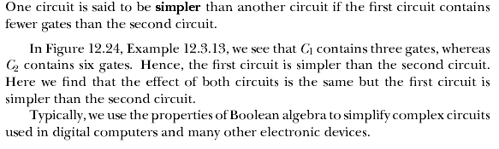

Slide 49

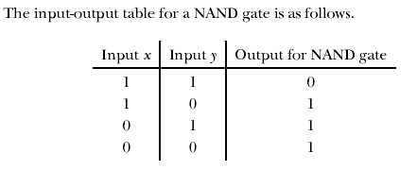

Slide 50


Slide 51
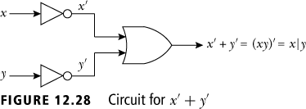


Slide 52

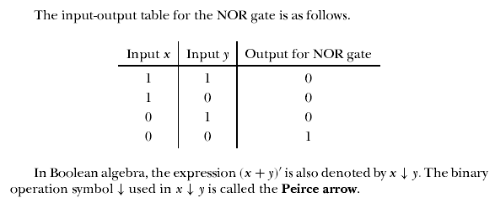

Slide 53


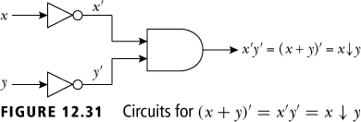


Slide 54
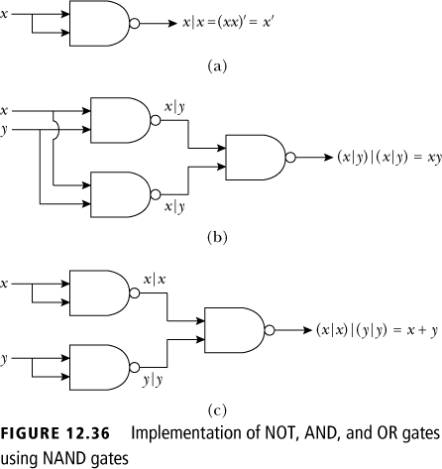
Logical Gates and Combinatorial Circuits
A NOT gate can be implemented using a NAND gate (a).
An AND gate can be implemented using NAND gates (b).
An OR gate can be implemented using NAND gates (c).

Slide 55
Canonical and Standard Form : Minterms and Maxterms
A binary variable may appear either in its normal form (x) or in its complement form (x’).
Now consider two binary variables x and y combined with an AND operation.
Since each variable may appear in either form, there are four possible combinations: xy, x’y, xy’, and x’y’.
Each of these four AND terms is called a minterm, or a standard product.
In a similar manner, n variables can be combined to form 2^{n} minterms.
The 2^{n} different minterms may be determined by a method similar to the one shown in a Table (next slide) for three variables.

Slide 56

Canonical and Standard Form : Minterms and Maxterms
The binary numbers from 0 to 2^{n} - 1 are listed under the n variables.
Each minterm is obtained from an AND term of the n variables, with each variable being primed if the corresponding bit of the binary number is a 0 and unprimed if a 1.
A symbol for each minterm is also shown in the table and is of the form mj , where the subscript j denotes the decimal equivalent of the binary number of the minterm designated.
A Boolean function can be expressed algebraically from a given truth table by forming a minterm for each combination of the variables that produces a 1 in the function and then taking the OR of all those terms.

Slide 57
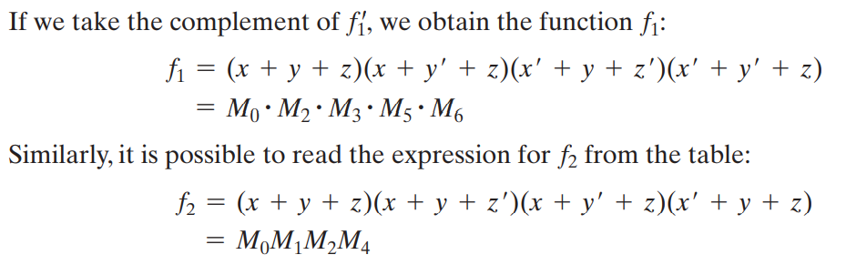
Canonical and Standard Form : Minterms and Maxterms
Boolean functions expressed as a sum of minterms or product of maxterms are said to be in canonical form.

Slide 58
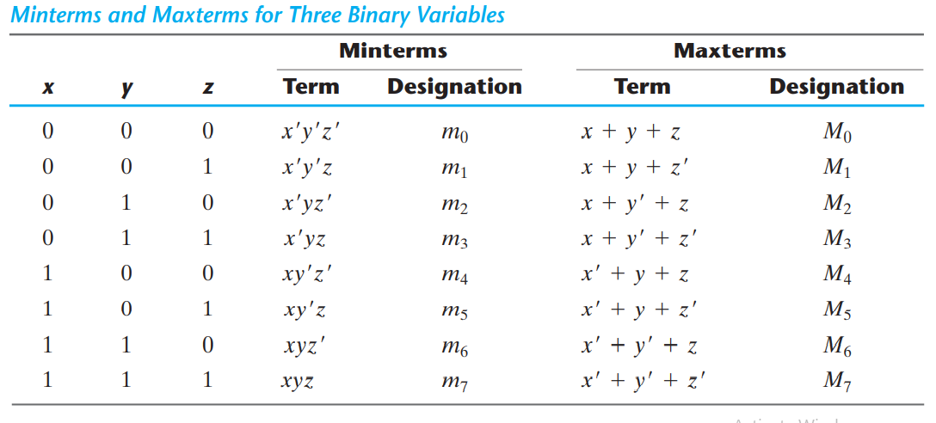
Canonical and Standard Form : Minterms and Maxterms

Slide 59
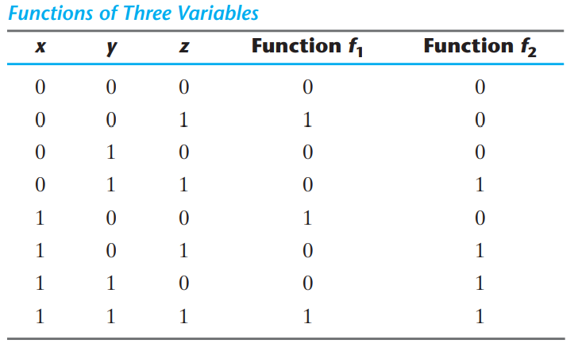
Canonical and Standard Form : Minterms and Maxterms

Slide 60
Sum of Minterms
The minterms whose sum defines the Boolean function are those which give the 1’s of the function in a truth table.
Function can be either 1 or 0 for each minterm, and since there are 2^{n} minterms
Convenient to express a Boolean function in its sum‐of‐minterms form.
If the function is not in this form, it can be made so by first expanding the expression into a sum of AND terms.
Each term is then inspected to see if it contains all the variables.
If it misses one or more variables, it is ANDed with an expression such as x + x, where x is one of the missing variables.
The next example clarifies this procedure.

Slide 61
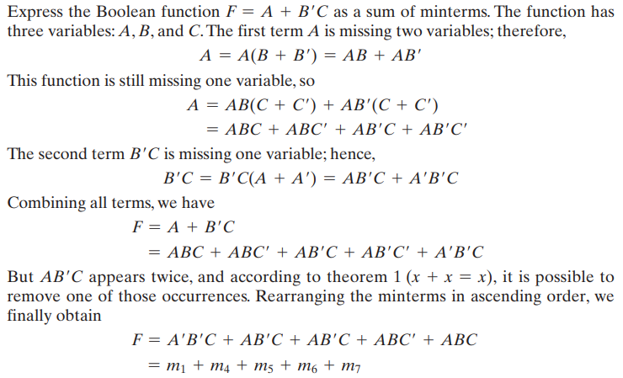
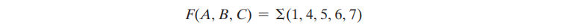
Example
It is sometimes convenient to express the function in the following brief notation.

Slide 62
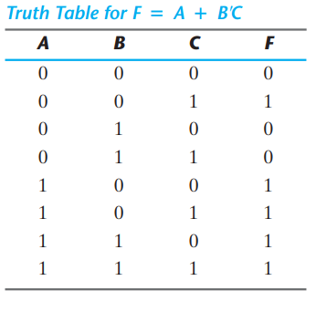
Alternative procedure for deriving the minterms
Consider the Boolean function given in previous Example
F = A + B’C
The truth table can be derived directly from the algebraic expression by listing the eight binary combinations under variables A, B, and C and inserting 1’s under F for those combinations for which A = 1 and BC = 01.
From the truth table, we can then read the five minterms of the function to be 1, 4, 5, 6, and 7.

Slide 63
Alternative procedure for deriving the minterms
Consider the Boolean function given in previous Example
F = A + B’C
The truth table can be derived directly from the algebraic expression by listing the eight binary combinations under variables A, B, and C and inserting 1’s under F for those combinations for which A = 1 and BC = 01.
From the truth table, we can then read the five minterms of the function to be 1, 4, 5, 6, and 7.

Slide 64
Alternative procedure for deriving the minterms
Consider the Boolean function given in previous Example
F = A + B’C
The truth table can be derived directly from the algebraic expression by listing the eight binary combinations under variables A, B, and C and inserting 1’s under F for those combinations for which A = 1 and BC = 01.
From the truth table, we can then read the five minterms of the function to be 1, 4, 5, 6, and 7.

Slide 65


Example of Maxterms

Slide 66

Conversion between Canonical Forms

Slide 67



Conversion between Canonical Forms
We now state a general conversion procedure:
To convert from one canonical form to another, interchange the symbols and
and list those numbers missing from the original form.
In order to find the missing terms, one must realize that the total number of minterms or maxterms is 2^{n} , where n is the number of binary variables in the function.
A Boolean function can be converted from an algebraic expression to a product of maxterms by means of a truth table and the canonical conversion procedure.
Consider, for example, the Boolean expression F = xy + x’z
First, we derive the truth table of the function
The 1’s under F in the table are determined from the combination of the variables for which xy = 11 or xz = 01.
The minterms of the function are read from the truth table to be 1, 3, 6, and 7.
The function expressed as a sum of minterms is
$$Σ$$
$$Π$$

Slide 68

Conversion between Canonical Forms
Since there is a total of eight minterms or maxterms in a function of three variables, we determine the missing terms to be 0, 2, 4, and 5. The function expressed as a product of maxterms is
the same answer as obtained in Previous Example.

Slide 69

Conversion between Canonical Forms

Slide 70
Canonical Form: Sum of Minterms
F(X,Y,Z) = X’Y’+Z
= X’Y’(Z+Z’)+Z(X+X’)(Y+Y’)
= X’Y’Z+X’Y’Z’+(ZX+ZX’)(Y+Y’)
= X’Y’Z’+X’Y’Z+X’YZ+XY’Z+XYZ
= m0+m1+m3+m5+m7
= ∑(m0+m1+m3+m5+m7)
= ∑m(0,1,3.5,7)
Product of minterms 0,1,3.5.7

Slide 71
Canonical Form: Product of Maxterms
F(X,Y,Z) =X’Y’+Z
=Z+X’Y’
= (Z+X’)(Z+Y’) Using Distributed law
=(X’+YY’+Z)(XX’+Y’+Z)
=(X’+Y+Z)(X’+Y’+Z) (X+Y’+Z)(X’+Y+Z)
=(X’+Y+Z)(X’+Y’+Z) (X+Y’+Z)
=M₄M₆M₂
=∏(M₄M₆M₂) =∏M (2,4,6)
Product of Maxterm 2, 4, 6

Slide 72

Canonical Forms
Example in slide 3 and 4 ∑m(0,1,3.5,7) =∏M (2,4,6)
In general ∑m({x}) =∏M ({y})
Where $\left\{x\right\}∪ \left\{y\right\}=\left\{0,1,2, … 2^{n−1}\right\} and$
$\left\{x\right\}∩ \left\{y\right\}=\left\{⊘\right\}$
A function expressed as a sum of minterms can also be expressed as the product of the opposite maxterms

Slide 73

Canonical Forms: Minterms and Maxterms
A sum of minterms equals the inverse of the product of the same maxterms
$$\sum{m\left(\left\{x\right\}\right)=\overline{\prod{M(\left\{x\right\})}}}$$
Proof:
$$\overline{\prod{M(\left\{x\right\})}}=\overline{\left(M_{x_{1}}.M_{x_{2}}……M_{x_{k}}\right)}$$
$=\overline{M_{x_{1}}}+\overline{M_{x_{2}}}+…\overline{M_{x_{k}}}$
$$=m_{x_{1}}+m_{x_{2}}+…+m_{x_{k}}$$
$$=\sum{m\left(\left\{x\right\}\right)}$$

Slide 74
Canonical/Standard Forms
There are two types of standard forms:
Sum of products (SOP) and
Products of sums (POS).

Slide 75
Sum of Product (SOP)
0
SOP form
POS form
1
Directly written from Truth Table
0
1
1
Canonical/ Standard form
F=x’yz’+xy’z’+xy’z+xyz’+xyz
= x’yz’+xy’[z’+z]+xy[z’+z]
=x’yz’+xy’+xy
=x’yz’+x[y’+y]
= x’yz’+x
= x+yz’ [Distributed law A+A’B=A+B)]
Each minterm is having all the variable or complemented form
Each minterm does not have all the variables in normal or complemented form
Minimal SOP form

Slide 76

Standard Forms: Two‐level implementation
y’+x’yz’+xy

Slide 77

Standard Forms: Conversion from other form
A Boolean function may be expressed in a nonstandard form
Example: F₃ = AB + C(D + E)
Neither in sum‐of‐products nor in product‐of‐sums form.
Two-level produces the least amount of delay through the gates when the signal propagates from the inputs to the output.
Sum of Product
3-> 2 level

Slide 78
Constructing Gates
Transistor
A device that acts either as a wire that conducts electricity or as a resistor that blocks the flow of electricity, depending on the voltage level of an input signal
A transistor has no moving parts, yet acts like a switch
It is made of a semiconductor material, which is neither a particularly good conductor of electricity nor a particularly good insulator

Slide 79

How is the behavior implemented
B
E

Slide 80
Circuits
Combinational Circuit
The input values explicitly determine the output
Sequential Circuit
The output is a function of the input values and the existing state of the circuit

Slide 81
THANKS

